Slide 1
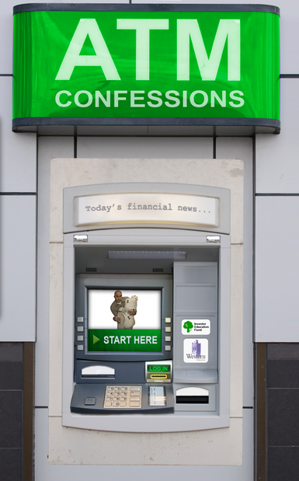
This ATM has 3 options. However, it will only work for each person one time.
Button 1—Will give you a gift of $10,000
Button 2—Will give you and 3 other random people a gift of $5,000
Button 3—Will give you and 25 other random people a gift of $2,000
Using plenty of details, explain which button you push and why. Or, would you decide not to push a button?

Slide 2
Introductory Assignment: Pick ONE
Make a pictorial collage that represents the meaning of “greed”.
**BUT you can’t use any pictures of money or gold coins--too obvious.
Think about what greed looks like. How do you know someone is excessive or greedy?
Use pictures. Limit words to VERY few. Be thoughtful—everyone can go to google images and type in greed—do more than that. Have at least 10 arranged pictures. It is a collage, not a line. Can be digital or on paper. (Magazines encouraged)
Find greed represented in media/pop culture and analyze
**This means a book, a song, a movie, or a video game
Answer the questions & use complete sentences whenever possible
1. Where is this from?
2. Explain in detail how greed is represented.
3. What does it mean?
4. How is this message about greed meant to influence people?

Slide 3
Chapter 1 pages 1-12
Central Idea Example
The scurrying procession came at last to the big gate in the wall of the doctor's house. They could hear the splashing water and the singing of caged birds and the sweep of the long brooms on the flagstones. And they could smell the frying of good bacon from the doctor's house.
Central idea—The doctor is wealthy and extravagant (compared to the island people.)
Notice that this sentence is my own words and synthesizes all the biggest points into one central idea.

Slide 4
Chapter 1 pages 1-12
Central Idea Practice
The lit circles should number off. Each circle take the paragraph that corresponds with your number and write a central idea sentence. Your sentence SHOULD NOT summarize the paragraph. It SHOULD share the central idea in your own words. Work on this together and agree on one as a group; also pick someone to share it.
p 8 “They came to a place where….” paragraph
p 8 “And the new comers, particularly…” paragraph
p 9 “Kino hesitated a moment…”
p 10 “In his chamber the doctor…” STOP at cigarettes
5. p 10 mid paragraph “The furnishings of the room…”
6. P 11 “Now Kino reached into a secret place somewhere…”

Slide 5
Chapter 1 pages 1-12
Literature Circle Assignment
Work as a group to complete one assignment. Everyone writes/types. Discuss and do your best possible work!
Select one sentence that shows the idea of greed in this chapter. Explain why you selected this sentence.
2. Answer the question in multiple sentences, how does greed impact the conflict?

Slide 6
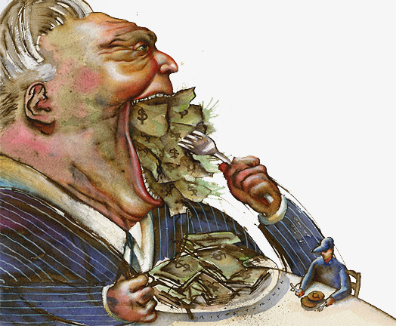
Can greed ever be good?
Read the article Greed is Good???

Slide 7
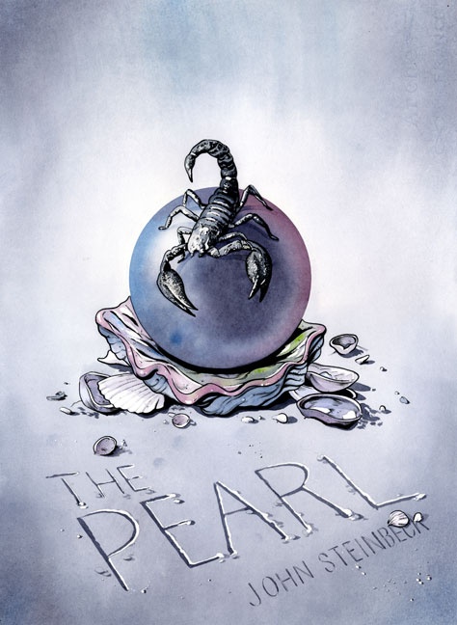
Independent Reading Assignment Chapters 2 & 3
Pages 13-40

Slide 8
Chapters 2 & 3
Complete the PEA table.
Add the missing parts. All Analysis should be a minimum of 4 sentences.

Slide 9
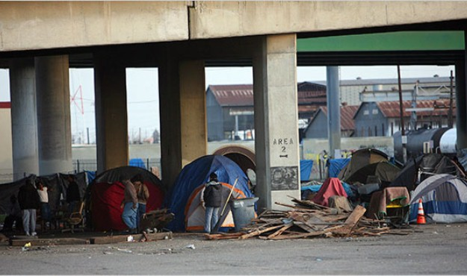
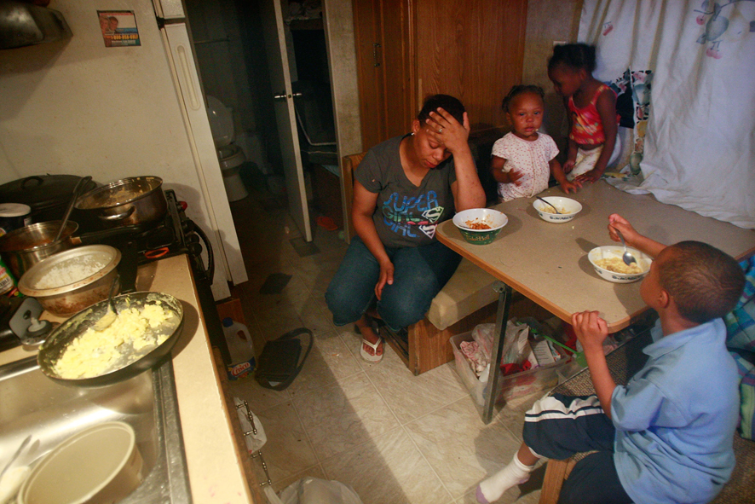
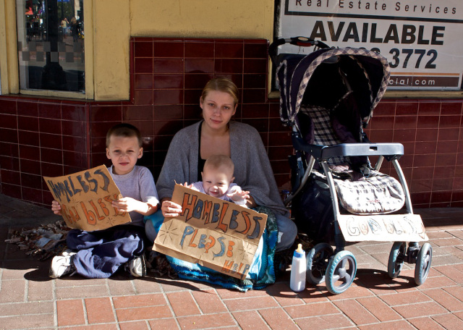
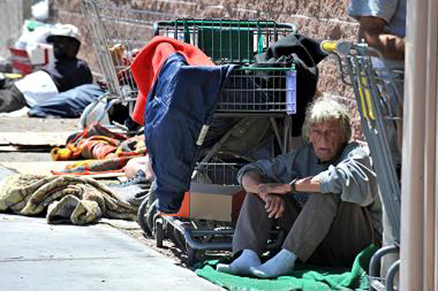
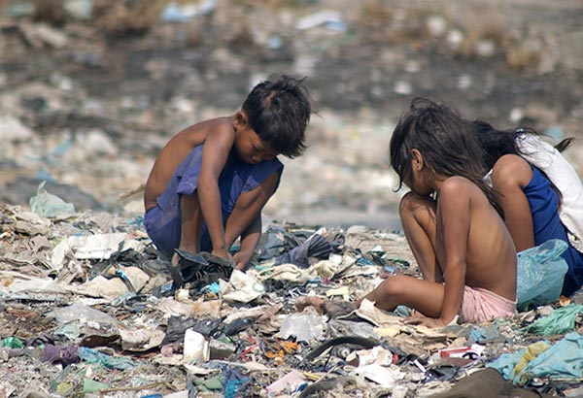
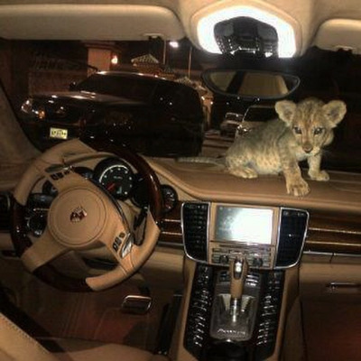
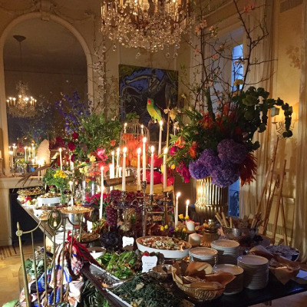
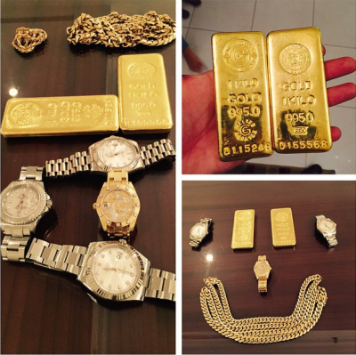
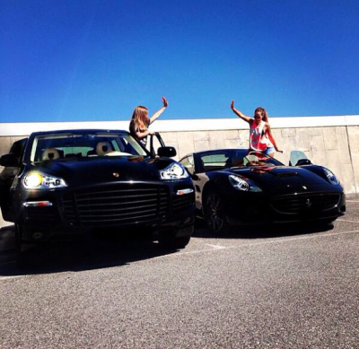
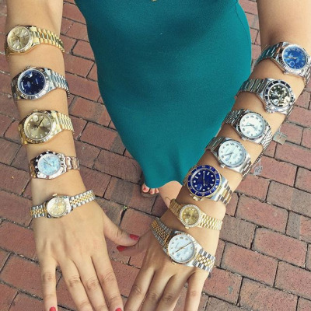
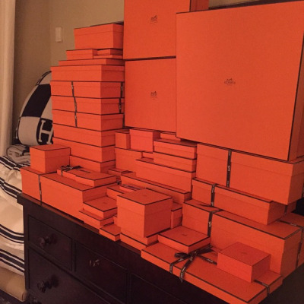
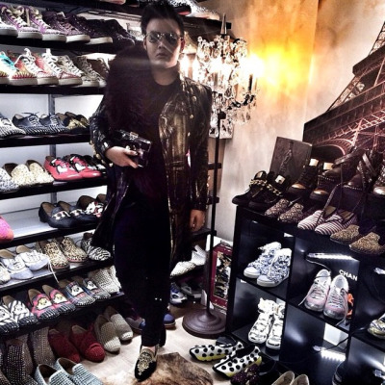
How much stuff is too much? When does having material possessions make you greedy?
http://www.theguardian.com/commentisfree/2013/dec/09/materialism-system-eats-us-from-inside-out
Image from
http://storyofstuff.org/movies/story-of-stuff/

Slide 10
Should some people have so much,
while others have so little?
embedded video https://www.youtube.com/watch?v=QPKKQnijnsM

Slide 11
Independent Reading Assignment Chapters 4 & 5
Pages 41-67

Slide 12
Chapter 4 Assignment: Work together in your lit. circle to make an origami balloon. Imagine this balloon is the pearl.
embedded video https://www.youtube.com/watch?v=1l8BC51PJ3Q

Slide 13
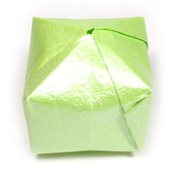
Now think of 3 different things/ideas the pearl represents in the novel. On your paper pearl, write what it stands for and a quote with a page number to support your idea. Only use chapters 4 & 5.

Slide 14
Chapter 5 Summary
____________________________________ wanted , but__________________________________________________________________________________________________________________________________________________________________________________________, so _______________________________________________________________________________________________________________________________________________________________________________________________________________________________________________.

Slide 15
Blackberry-Picking
BY SEAMUS HEANEY
for Philip Hobsbaum
Late August, given heavy rain and sun
For a full week, the blackberries would ripen.
At first, just one, a glossy purple clot
Among others, red, green, hard as a knot.
You ate that first one and its flesh was sweet
Like thickened wine: summer's blood was in it
Leaving stains upon the tongue and lust for
Picking. Then red ones inked up and that hunger
Sent us out with milk cans, pea tins, jam-pots
Where briars scratched and wet grass bleached our boots.
Round hayfields, cornfields and potato-drills
We trekked and picked until the cans were full,
Until the tinkling bottom had been covered
With green ones, and on top big dark blobs burned
Like a plate of eyes. Our hands were peppered
With thorn pricks, our palms sticky as Bluebeard's.
)
We hoarded the fresh berries in the byre.
But when the bath was filled we found a fur,
A rat-grey fungus, glutting on our cache.
The juice was stinking too. Once off the bush
The fruit fermented, the sweet flesh would turn sour.
I always felt like crying. It wasn't fair
That all the lovely canfuls smelt of rot.
Each year I hoped they'd keep, knew they would not.

Slide 16
Let America Be America Again - Poem by Langston Hughes
Let America be America again. Let it be the dream it used to be. Let it be the pioneer on the plain Seeking a home where he himself is free. (America never was America to me.) Let America be the dream the dreamers
dreamed-- Let it be that great strong land of love Where never kings connive nor tyrants
scheme That any man be crushed by one above. (It never was America to me.) O, let my land be a land where Liberty Is crowned with no false patriotic wreath, But opportunity is real, and life is free, Equality is in the air we breathe. (There's never been equality for me, Nor freedom in this "homeland of the free.")
Say, who are you that mumbles in the dark? And who are you that draws your veil across the stars? I am the poor white, fooled and pushed apart, I am the Negro bearing slavery's scars. I am the red man driven from the land, I am the immigrant clutching the hope I seek-- And finding only the same old stupid plan Of dog eat dog, of mighty crush the weak. I am the young man, full of strength and hope, Tangled in that ancient endless chain Of profit, power, gain, of grab the land! Of grab the gold! Of grab the ways of satisfying need! Of work the men! Of take the pay! Of owning everything for one's own greed!
http://www.poemhunter.com/poem/let-america-be-america-again/

Slide 17
“This pearl has become my soul,”
http://www.nytimes.com/2014/01/19/opinion/sunday/for-the-love-of-money.html?_r=1

Slide 18
Independent Reading Assignment Chapter 6
Pages 68-90

Slide 19
Literature Circle—Important Word Summary
Use the key below to pick 2 of the most important words from each chapter. List your words for each chapter with a page number
Chapter 1—2 nouns
Chapter 2—a noun and a verb
Chapter 3—2 adjectives
Chapter 4—a verb and an adverb
Chapter 5—a subordinating conjunction and a noun
Chapter 6—a preposition and a noun
Take your important words and make a sentence or two to cover the big ideas in the story. You may add article adjectives a, an, the and conjunctions and, or, but, yet, so

Slide 20
http://www.ichernandez.org/cms/resources/documents/scope-010115-play-the-necklace.pdf

Slide 21
In the somber short story The Necklace Guy De Maupassant explores the theme greed for fine material possessions can lead to destruction.
Format to support this statement
Point explaining that Madame Loisel is greedy for material possessions
Evidence proving this. (quote)
Analysis of the evidence. (multiple sentences)
Point explaining Madame Loisel’s destruction
Evidence proving this. (quote)
Analysis of the evidence. (multiple sentences)
Concluding Sentence (bring it back to the point)

Slide 22
embedded video https://www.youtube.com/watch?v=Tjnq5StX68g

Slide 23
https://www.youtube.com/watch?v=oi2n-rlj4PU
https://www.youtube.com/watch?v=eHyhYa9CQcQ
http://www.npr.org/2008/03/28/89164759/a-victim-treats-his-mugger-right
https://www.youtube.com/watch?v=c9M8fjkdzVs
https://www.youtube.com/watch?v=fDluvii5H0U
possible useful links

Slide 24
Write a detailed paragraph comparing how greed motivates the characters of Roger in Thank You Ma’am and Madame Loisel in The Necklace.

Slide 25
If greed is a problem,
how do we solve it?
Doing independent research, come up with an idea.

