Slide 1
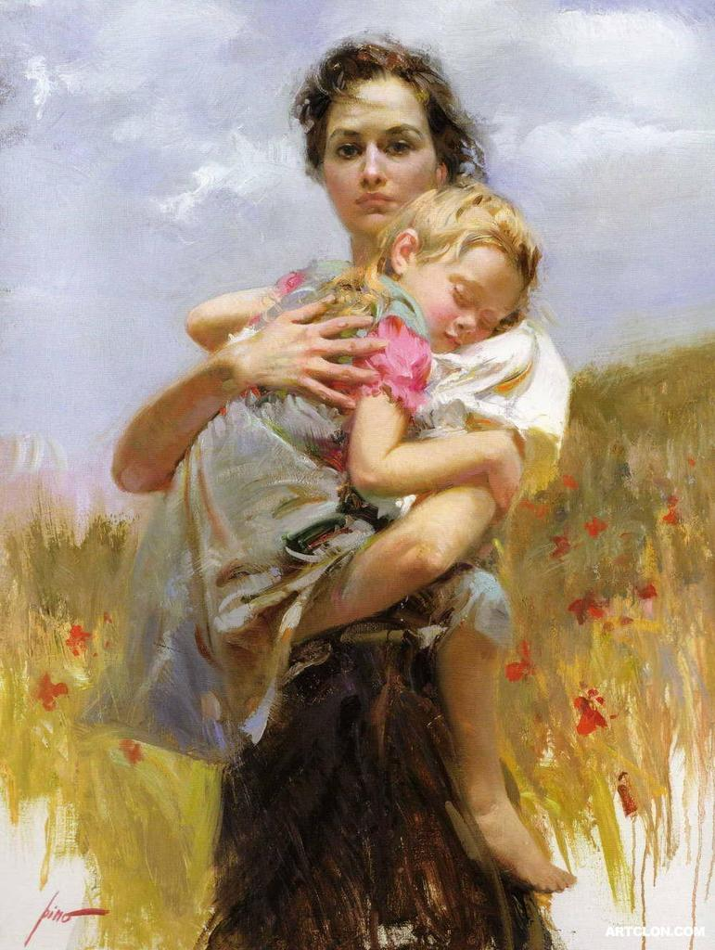
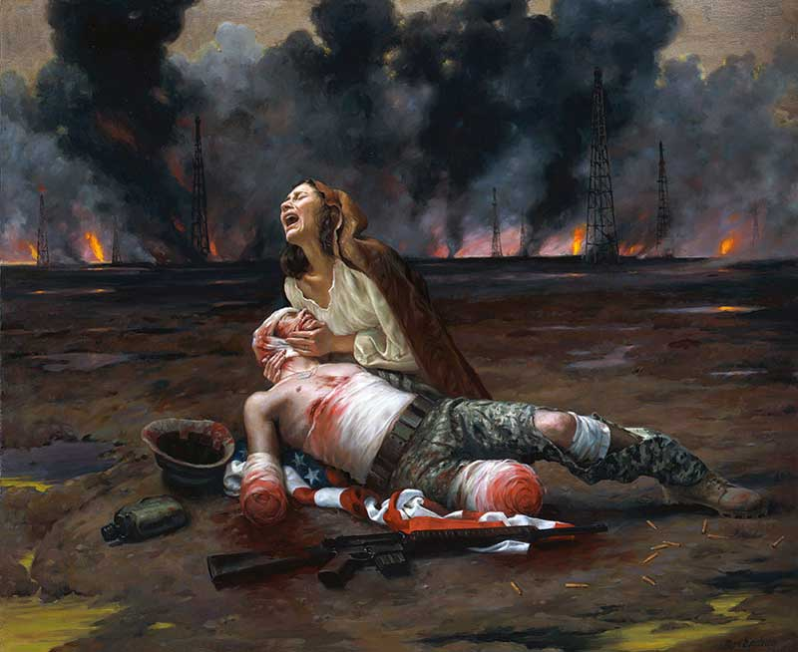
Which word best goes with this painting?
Love
War
Determination
Nature
Time
Hope
Now what is the painting showing about the word you picked?

Slide 2
The universal message. This is greater/larger than the text, so it DOES NOT INCLUDE the characters or events.
The main idea of what the story is about. This CAN INCLUDE the characters and/or events.

Slide 3
When figuring out theme it is always good to start with this word list. (this is a partial list)
Love
War
Acceptance
Success
Hope
Family
Dreams
Freedom
Courage
Beauty
Loss/Death
Forgiveness
Happiness
Identity
Nature
Pride
Work
Imagination
Knowledge
Friendship

Slide 4
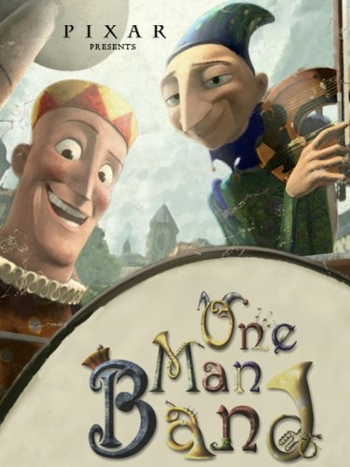
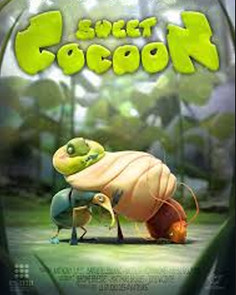
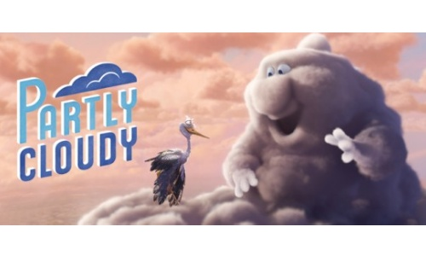

Slide 5
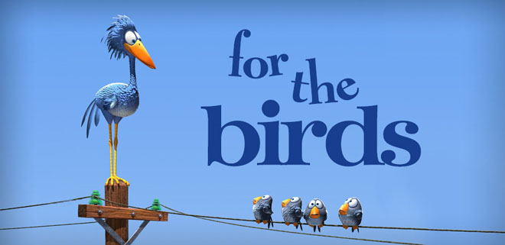

Slide 6
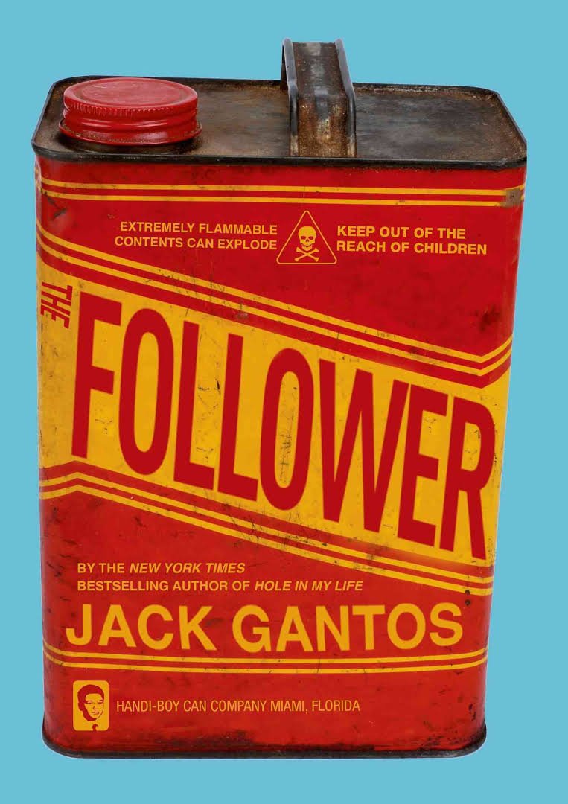

Slide 7
One Man Band—2 musicians compete desperately for a single coin but are worse in the end
Theme—Competition makes people work harder --or– Success means getting paid
Sweet Cocoon—With hard work and help, the caterpillar is able to transform only to be quickly gobbled up
Theme—Beauty is temporary. --or—Death can be found at the height of happiness --or– Friendship involves hard work
Partly Cloudy The storm cloud’s stork has a more painful job, but sticks it out.
Theme—Even difficult people deserve friendship. Finding good in others can involve sacrifice.

